Slide 1
Mr. Sandman’s New Refinish Solution: A Revolutionary Refinishing System
Anthony F. Magaro, Founder
Wood Floors by Mr. Sandman, Inc.®
Copyright 2011 © Mr. Sandman, Inc. All Rights Reserved.

Slide 2
New Refinish Solution
A proprietary solution that is used in combination with sanding to remove most wear and tear on almost any finished wood surface. This process eliminates the need for drum and edger sanders. It works on:
Wax floors
Engineered floors
Bamboo floors
Prefinished floors
Hand-scraped floors
Old urethanes
Thin floors where traditional sanding is not possible
Cabinetry, Railings, Furniture & More
Just about anything that has an existing finish system on wood where polyurethane is used as a finish system.

Slide 3
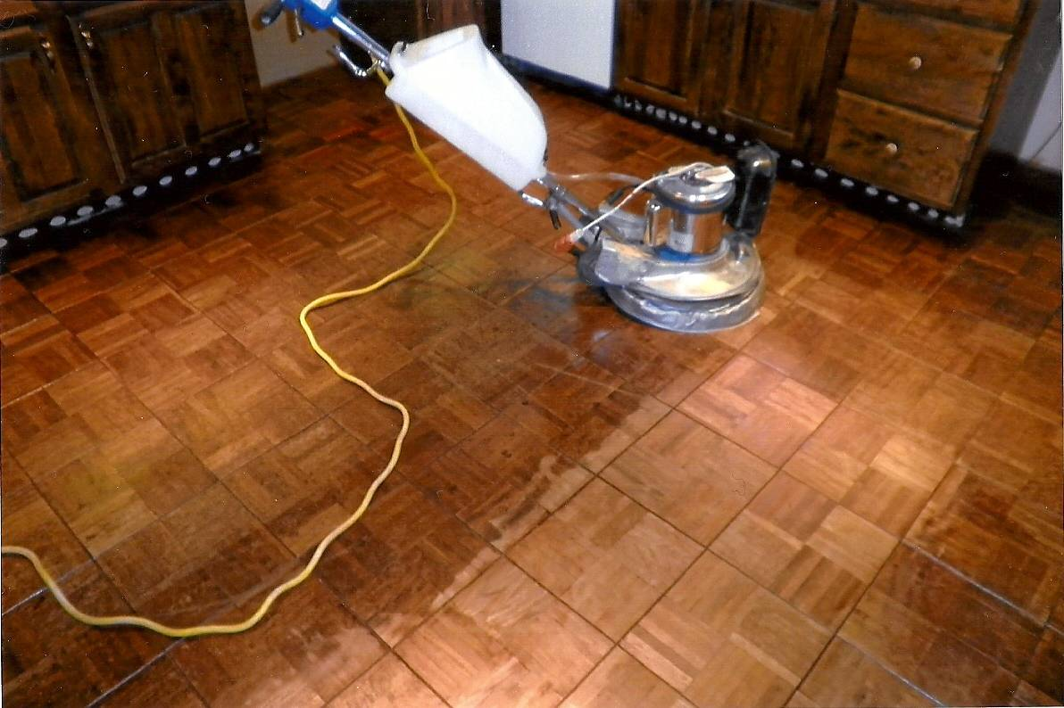
The Process: Step 1
New Refinish Solution
Wet Sand Existing Finish
A wet sand is performed. Some of this is done by hand, some is done by machine.
Once wet sanded, the surface is IMMEDIATELY ready for finishing.
With wet sanding, compression marks left by refrigerator and furniture were removed.
Notes:
3

Slide 4
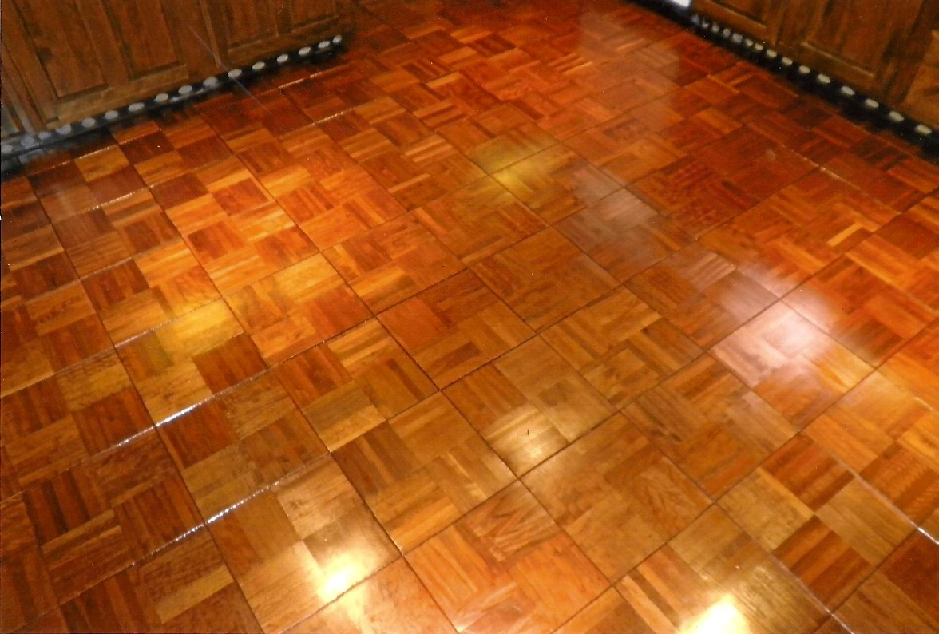
The Process: Step 2
New Refinish Solution
Finishing
A one or two coat polyurethane system is currently being used.
This particular panel showcases a four coat system
As a prep tack solution, the solution can be used to tack a finish system that has cured and is relatively clean for immediate finishing
Notes:
4

Slide 5
New Refinish Solution
Before & After:
Fifteen-year old urethane finish on stained Red Oak
Stained Red Oak: After completing solution and sanding process

Slide 6
New Refinish Solution
Before & After:
Oak stair treads
Oak stair treads

Slide 7
New Refinish Solution
Before & After:
Bamboo floor
Bamboo floor

Slide 8
New Refinish Solution
Before & After:
Notice areas where the finish is worn off and grayed out.
Areas are now restored to almost new unworn condition.

Slide 9
New Refinish Solution
Before & After:
Notice the heavy wear in the traffic areas.
Fabulous results without any drum sanding or edging.

Slide 10
New Refinish Solution
After: Furniture
Computer chair
End table

Slide 11
New Refinish Solution
Before & After:

Slide 12
New Refinish Solution
Before & After:
Severe grey out on a wafer thin floor.

Slide 13
New Refinish Solution
Before & After: Paint Removal

Slide 14
New Refinish Solution
Before & After: Paint Removal

Slide 15
New Refinish Solution
Before & After: Paint Removal

Slide 16
New Refinish Solution
Before & After: Urine Stain Removal

Slide 17
New Refinish Solution
Before & After: Urine Stain Removal

Slide 18
Testimonial for Previous Slide

Slide 19
New Refinish Solution
Before & After: Urine Stain Removal

Slide 20
New Refinish Solution
Before & After: Urine Stain Removal

Slide 21
New Refinish Solution
Before & After: Gym Floor
Notes:
21

Slide 22
New Refinish Solution
Notice the gouge below
(bottom middle)
Voila! COMPLETELY removed!

Slide 23
New Refinish Solution
Before & After:
100+ year old Pews

Slide 24
New Refinish Solution
Top portion shows a room completed
While the bottom portion shows a hallway not refinished

Slide 25
New Refinish Solution
Before & After:

Slide 26
New Refinish Solution
Before & After:

Slide 27
New Refinish Solution
Before & After:

Slide 28
New Refinish Solution
Before & After:

Slide 29
New Refinish Solution
Before & After:
Chestnut boards replaced window side

Slide 30
New RefinishSolution
Before & After: Chestnut floors

Slide 31
New Refinish Solution
Before & After: Chestnut Staircase

Slide 32
New Refinish Solution
Before & After:

Slide 33
New Refinish Solution
Before & After:

Slide 34
New Refinish Solution
Mr. Sandman can refinish half of the floor at a time solving the problem of “where do I put my furniture ?”

Slide 35
Testimony from recent client using Mr. Sandman’s NEW Refinish Solution

Slide 36
New Refinish Solution
Limitations
Instances where traditional drum and edger sanding is recommended to achieve full restoration :
Newly installed raw wood floors, which must be leveled with aggressive drum and edger sanders.
Floors that are severely water damaged.
Termite damaged floors.
Floors that require a color change.
Floors that require sanding error corrections
Finish system failure.

Slide 37
Conclusion
New Refinish Solution
Mr. Sandman’s New Refinish Solution for Wood Floor Refinishing & More is a revolutionary sanding and refinishing process that eliminates the need for the use of a drum sander and edger. Less time sanding and removing large amounts of material means less mess and floors that can be restored to a like-new condition even when worn out. It extends the life of the floor at a FRACTION of the cost of traditional sanding.
As a prep solution, finishes can be easily re-coated if a polyurethane system is used.
License opportunities available!
To contact Anthony, please email MrSandman61@gmail.com

